Slide 1
THE RETAIL ENVIRONMENT: TELFAR GLOBAL
Rachel Lozano

Slide 2
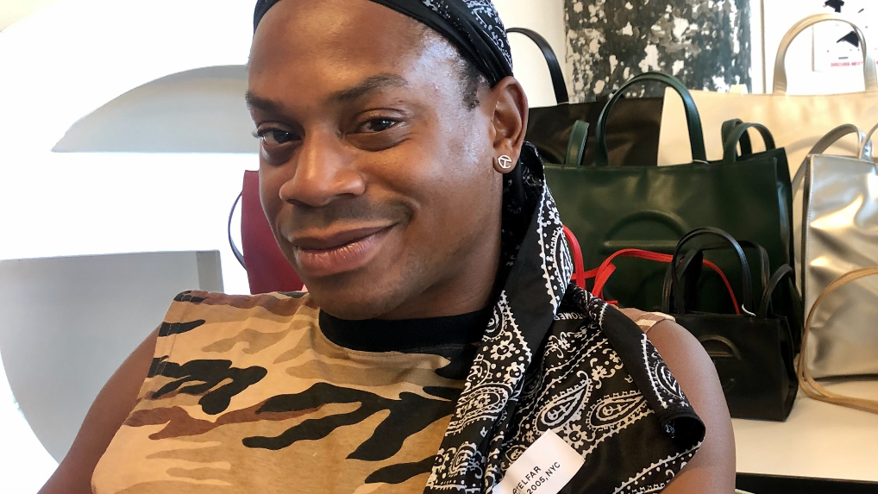
TELFAR CLEMENS

Slide 3
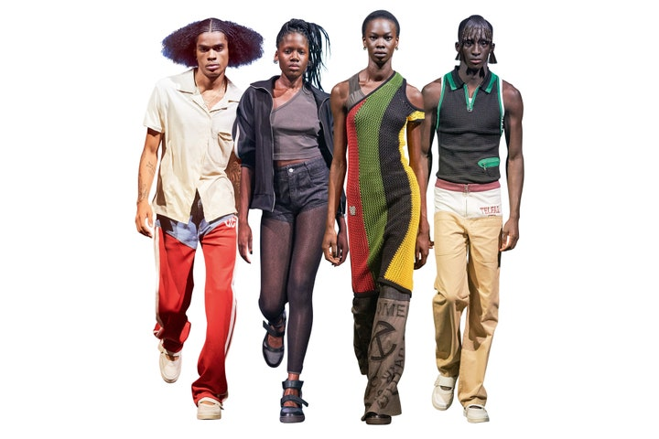
TELFAR GLOBAL

Slide 4
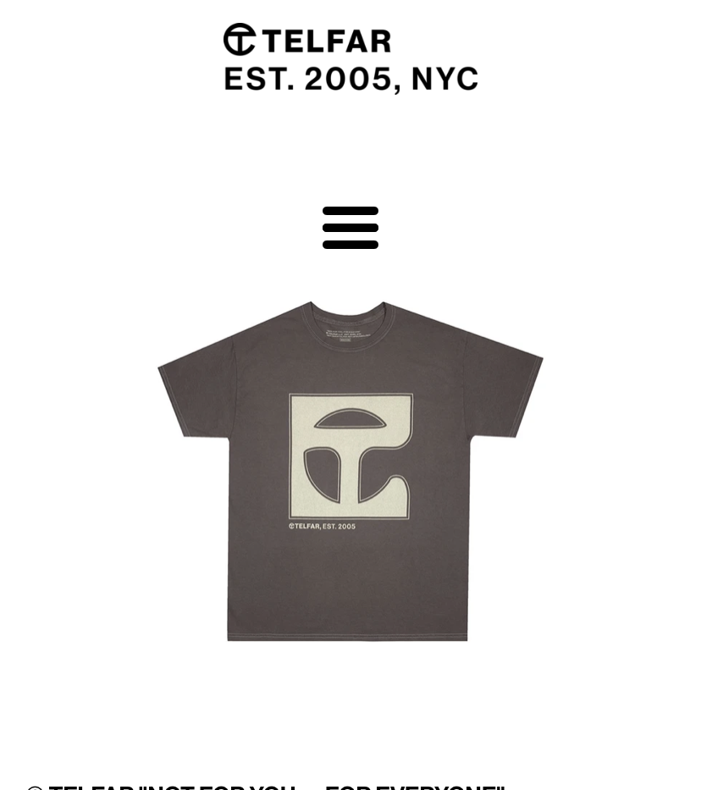
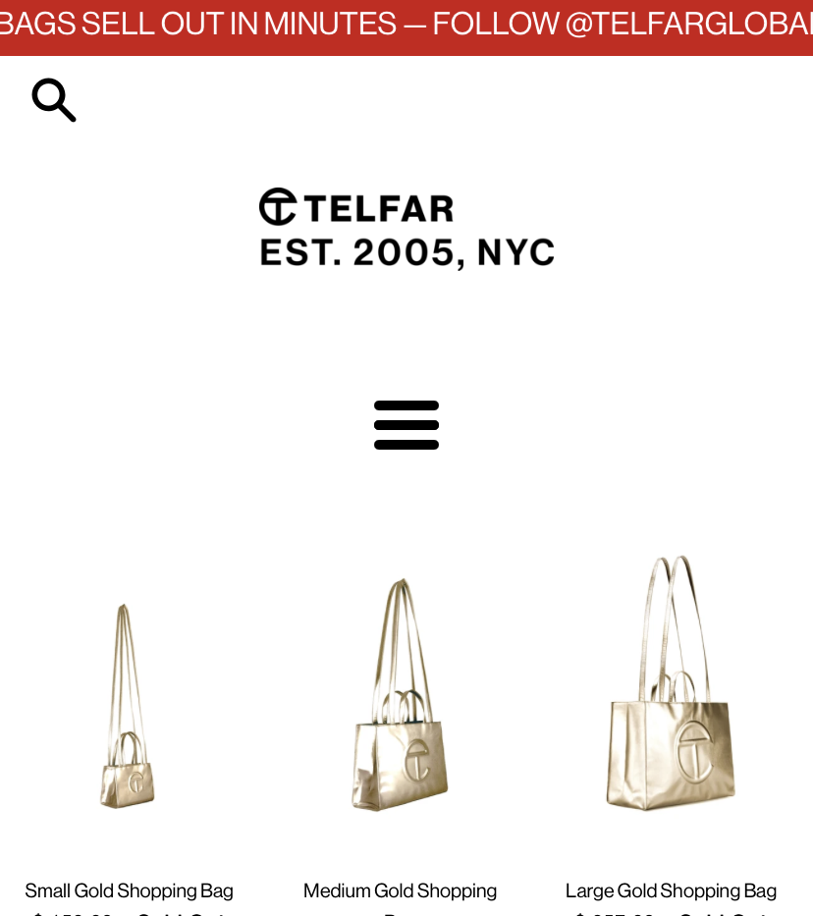

Slide 5
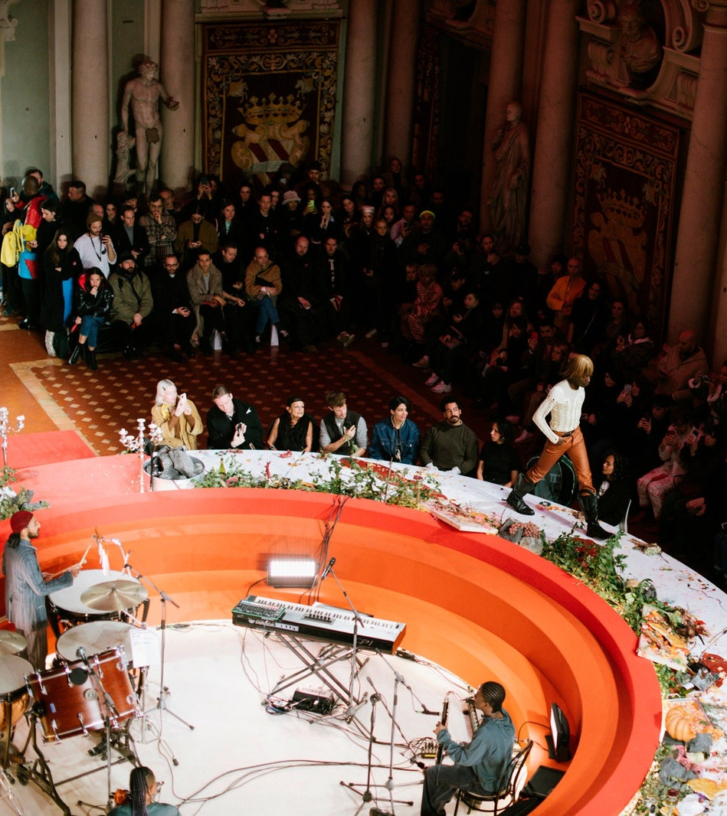
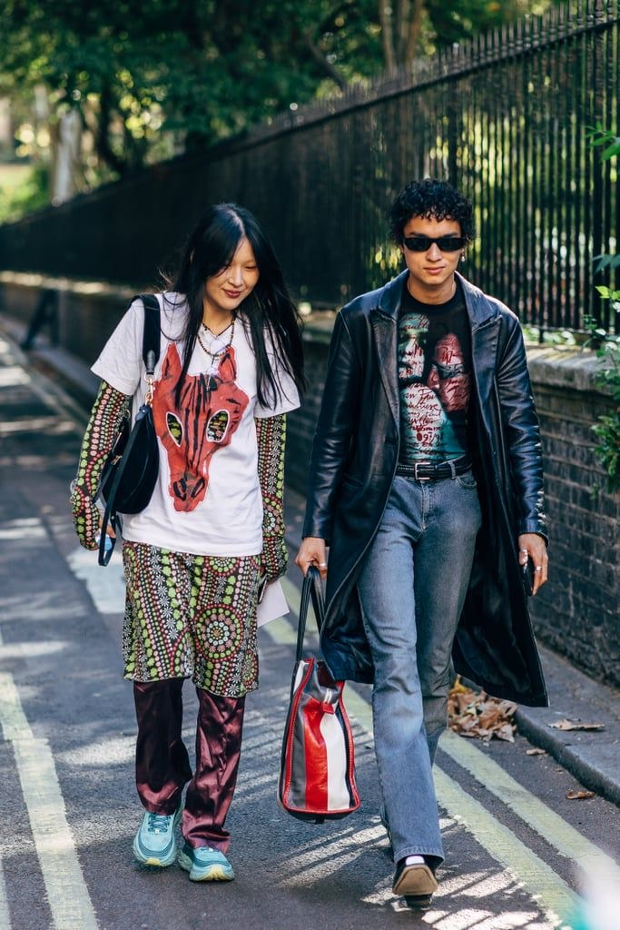
TARGET MARKET

Slide 6
THE GARMENT

Slide 7
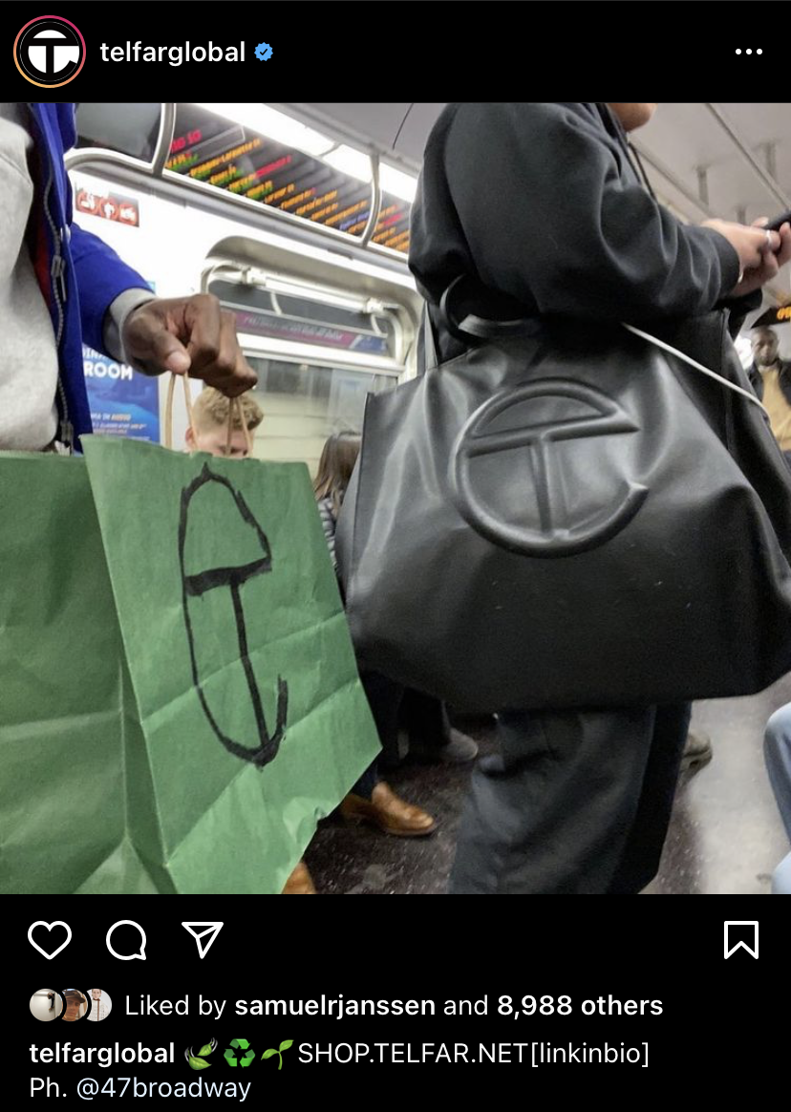
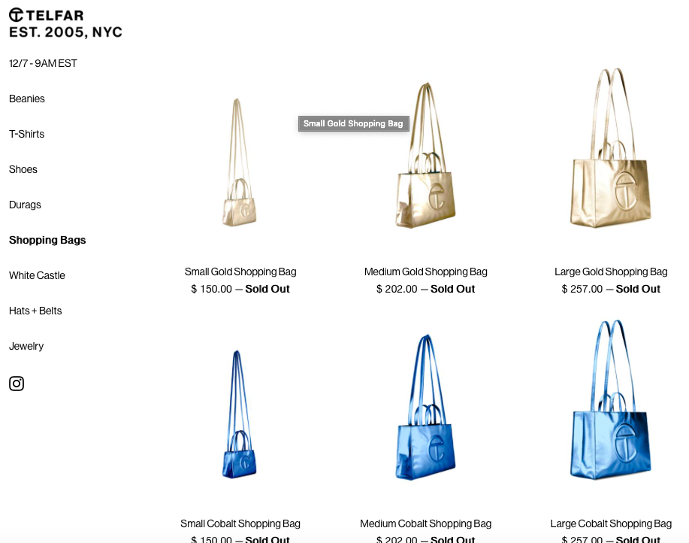
SHOPPING BAG: PRODUCTION

Slide 8
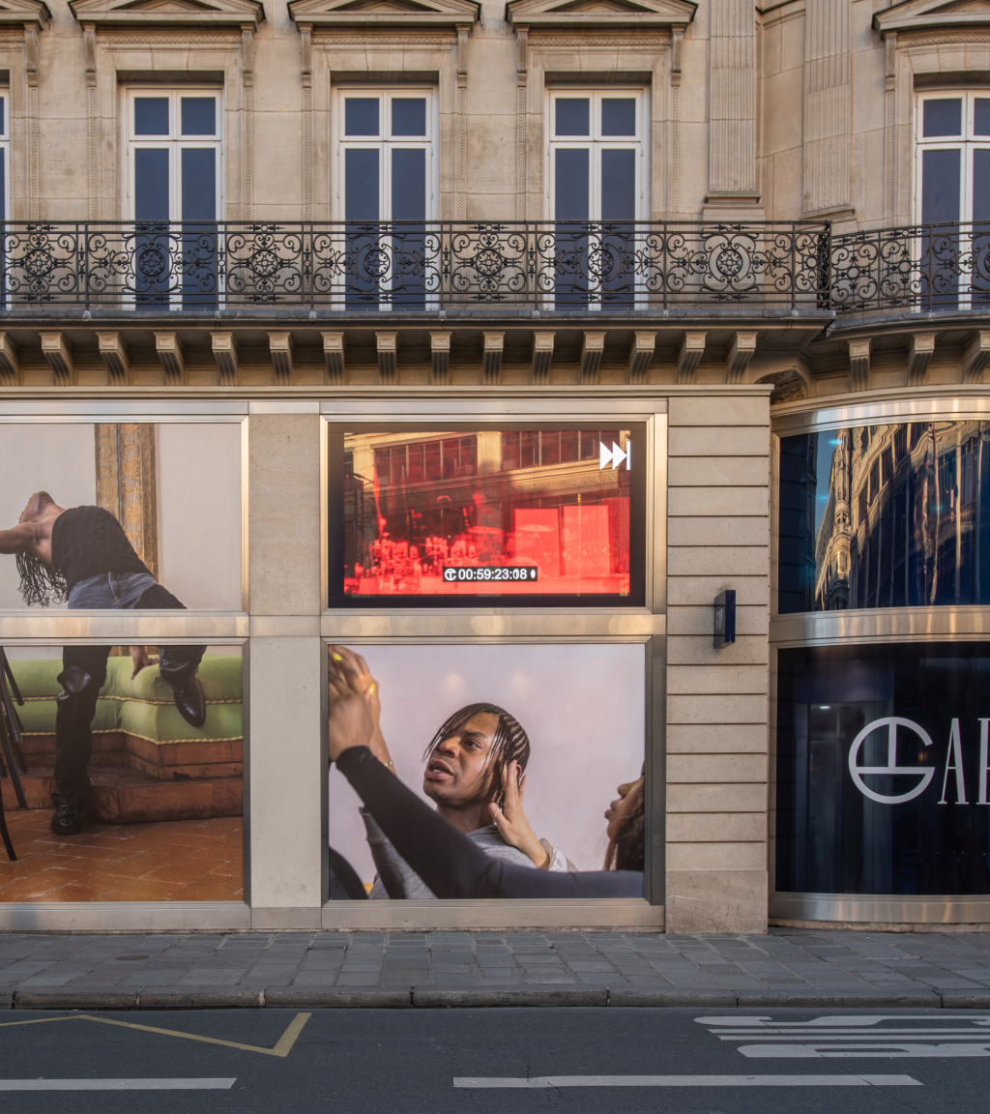
Marketing: Ads & Campaigns

Slide 9
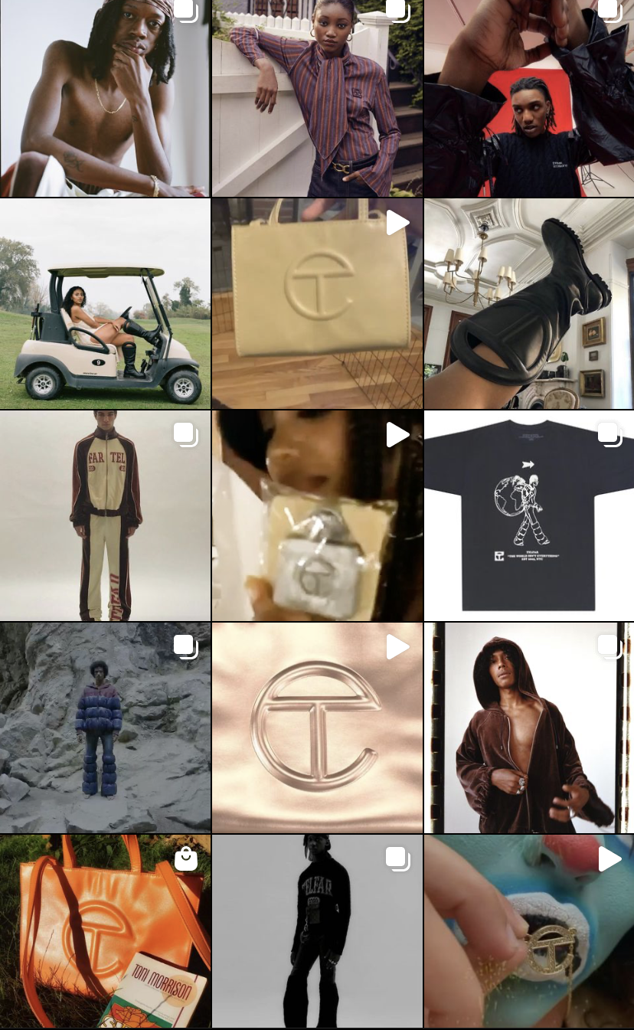
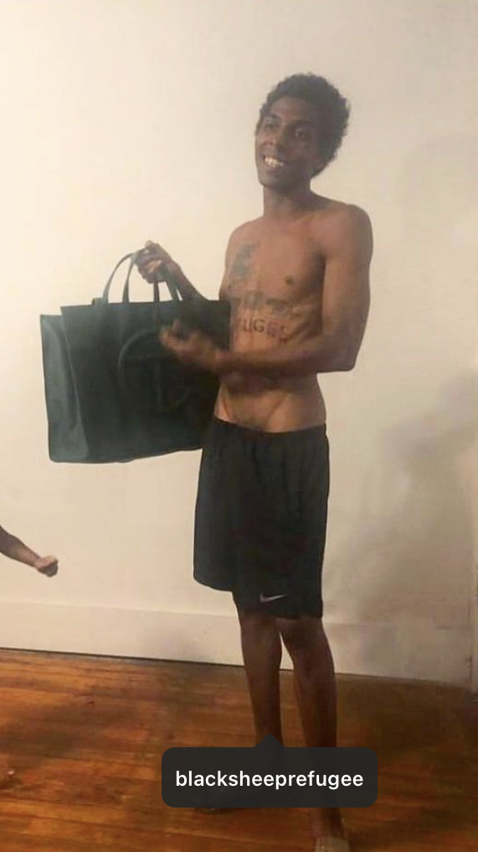
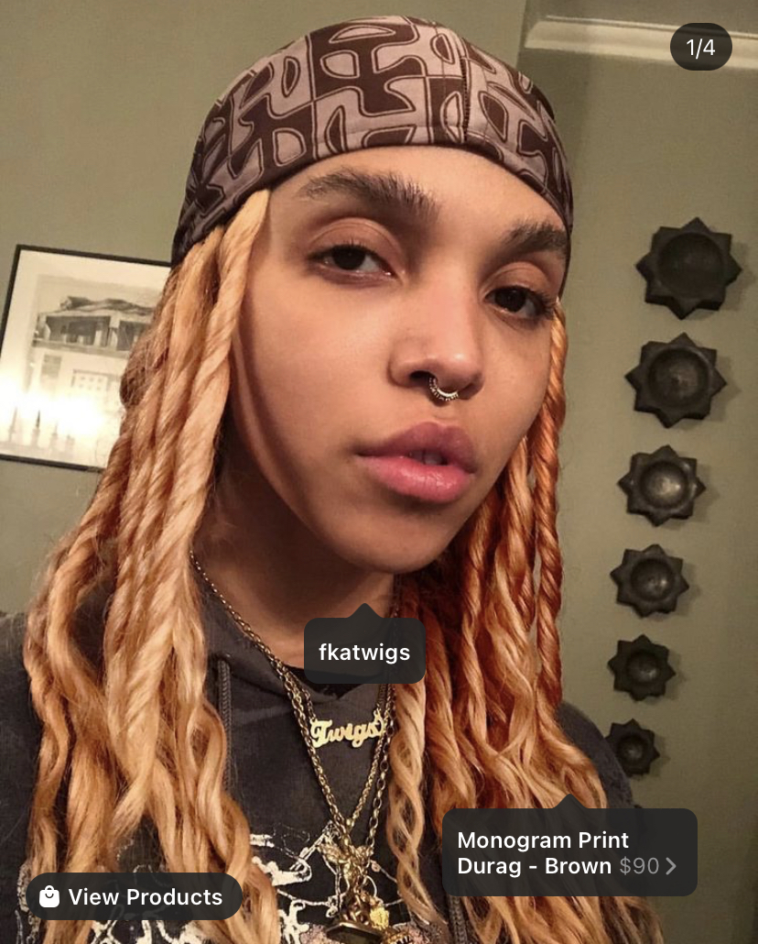
MARKETING: SOCIAL MEDIA

Slide 10
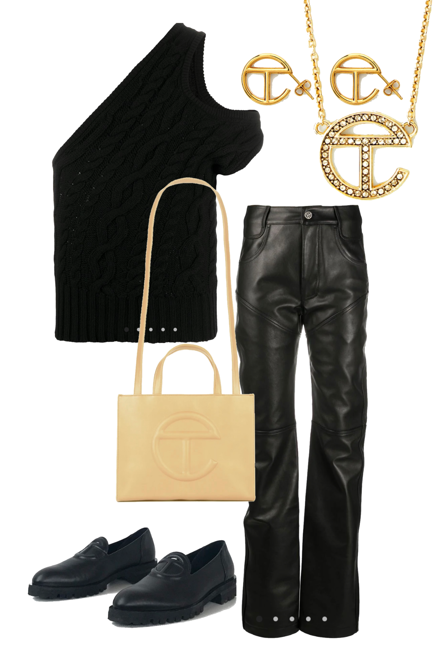
MOODBOARD

Slide 11
TOP: $434
PANTS: $1,090
LOAFERS: $499
NECKLACE: $240
EARRINGS: $175
MEDIUM BAG: $202

Slide 13
CURRENT MARKETPLACE

